Slide 1

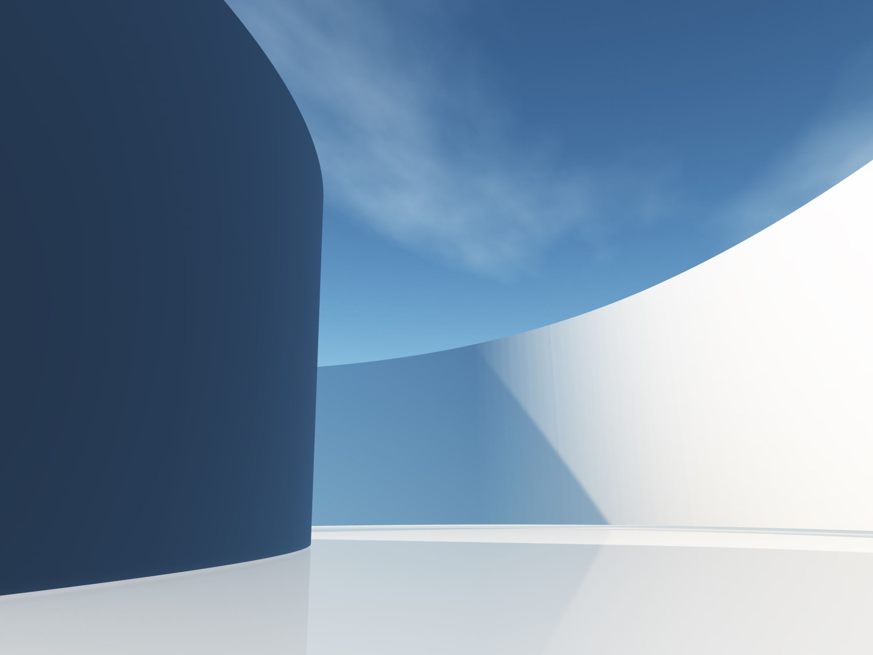

MRI Acquisition Simulator
Zachary Winter, Ian Wulf, Meron Dessie, Lisa Zuniga

Slide 2

Introduction
Simulate MRI data acquisition for virtual scanners, focusing on k-space.
Use MATLAB's FFT for efficient Fourier transforms.
Explore diverse k-space trajectories' impact on image quality.
Assess selective k-space sampling effects on image reconstruction.
Validate with two test phantoms replicating distinct tissue features.

Slide 3

Objective
Assess imaging outcomes using varied k-space trajectories and sampling strategies in MRI simulation.
Focus on Cartesian (2DFT spinwarp) and radial trajectories.
Modify parameters: line density, point density, line swapping, matrix width (Cartesian); line and point numbers (radial).
Study how these alterations affect image quality and fidelity in reconstructed images from k-space data.

Slide 4
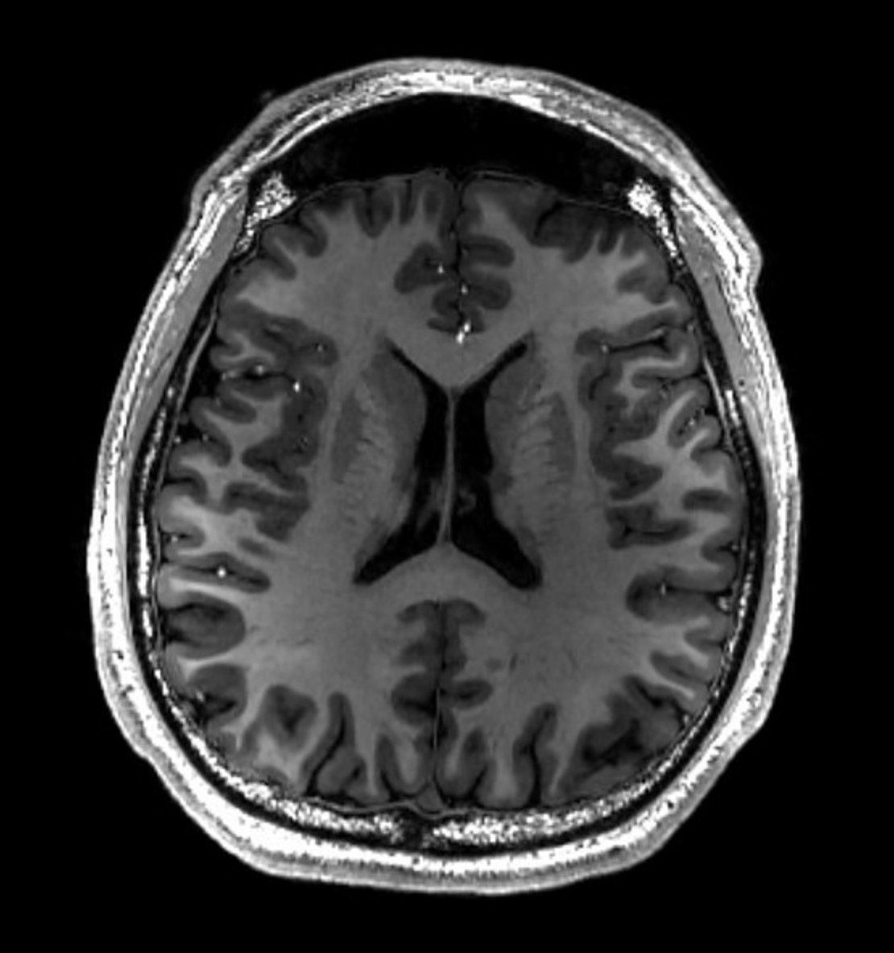
Methods
In this project we…
Created an MRI Acquisition
Performed image reconstruction
Implemented GUI
Conducted image analysis

Slide 5

Cartesian Sampling
Generates Cartesian grid
Creates circular mask and performs Fourier Transformation
Visuals k-space sample from image
Reads phantom image and performs Fourier Transformation with zero padding
Crops the k-space sample, repeats Fourier Transformation, then crops reconstruction
Scales and resizes image, generates sampled k-space and displays reconstructed image

Slide 6
Radial Sampling
Generates Cartesian grid
Creates circular mask and performs Fourier Transformation
Reads the input phantom image
Performs Radial transformation with different angles based on number of lines
Interpolates to 512 angles
Performs inverse Radon transformation
Displays reconstructed image

Slide 7

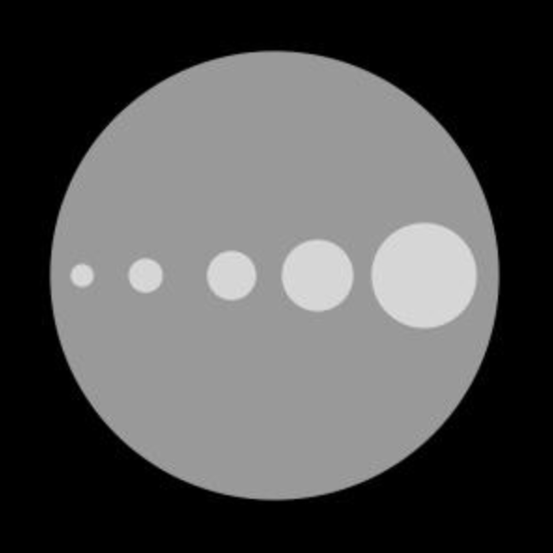
Phantoms
Phantom 1
Phantom 2

Slide 8
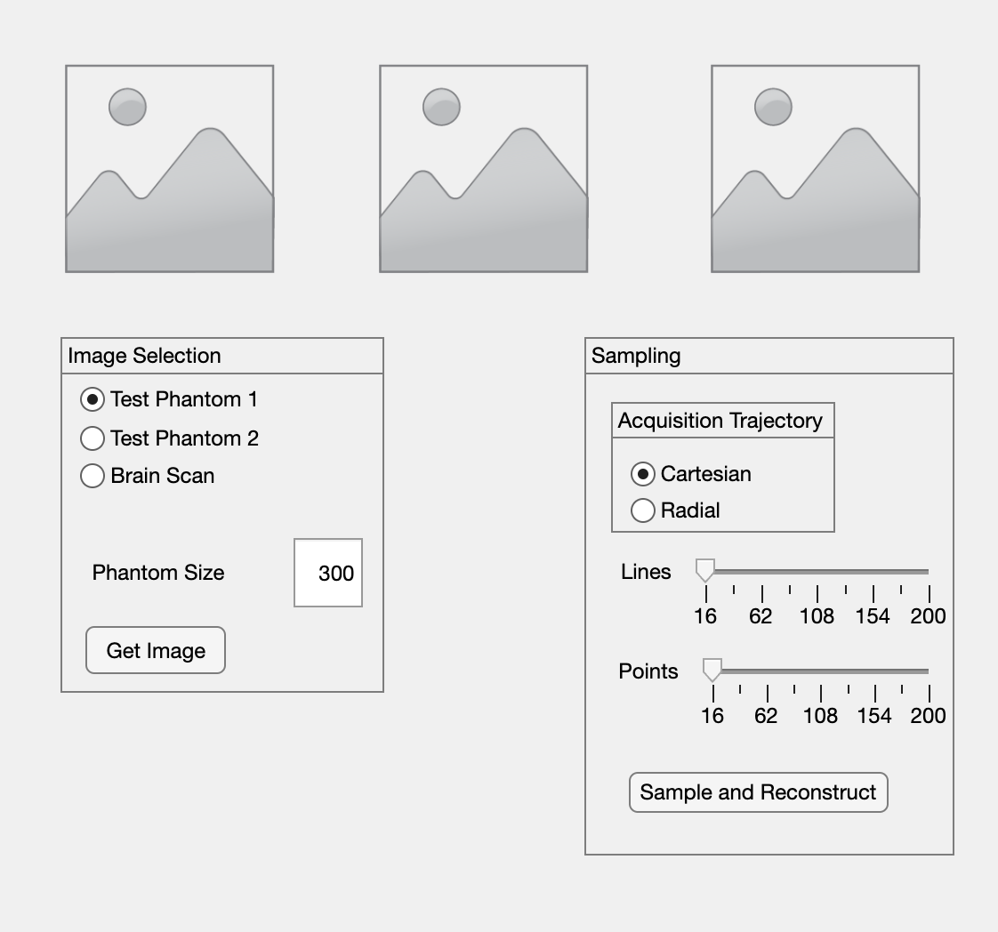
GUI Implementation
Consists of 3 modules
Image phantom
Acquired image
Difference between both

Slide 9
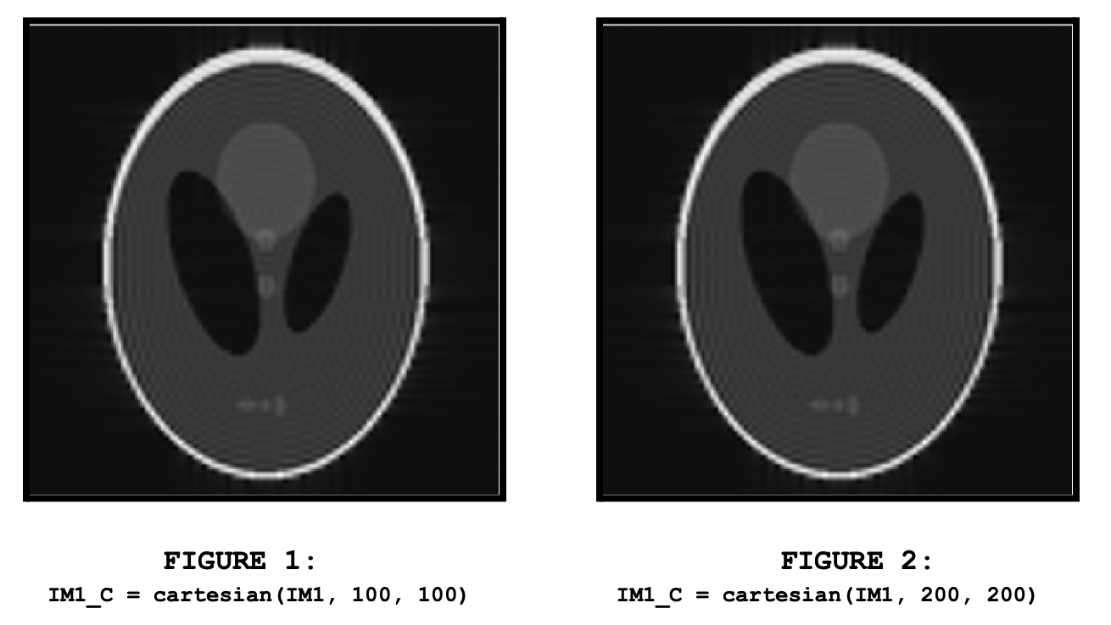
Cartesian Analysis

Slide 10
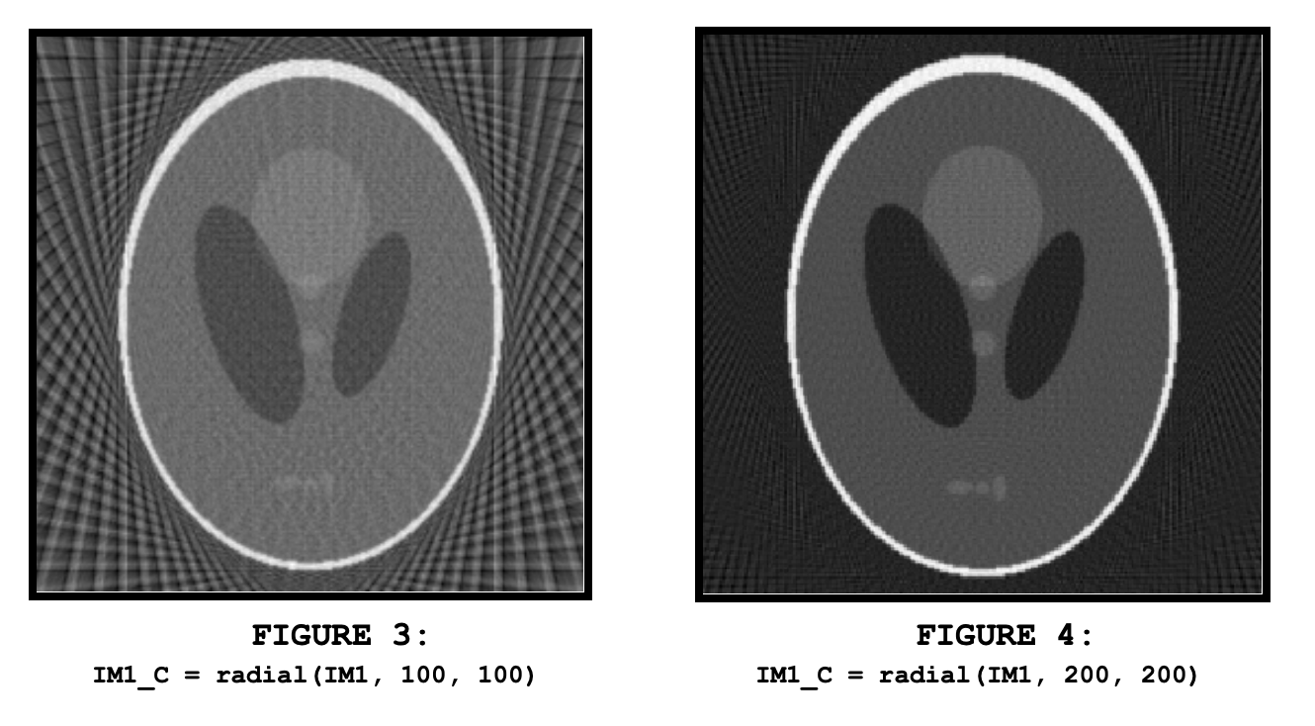
Radial Analysis

Slide 11
Results
Two phantom images generated
Both Cartesian and Radial Sampling techniques used
Each sampling technique reconstructed an image
Reconstructed images show effectiveness of sampling
Different samplings produce different results

Slide 12

Conclusion
Code allowed customization of image shapes, sizes, and backgrounds for phantoms
Cartesian and Radial functions showcase impact of parameter changes on image sharpness and quality
Code visually illustrates how parameter tweaks influence image reconstruction methodologies

